Slide 1

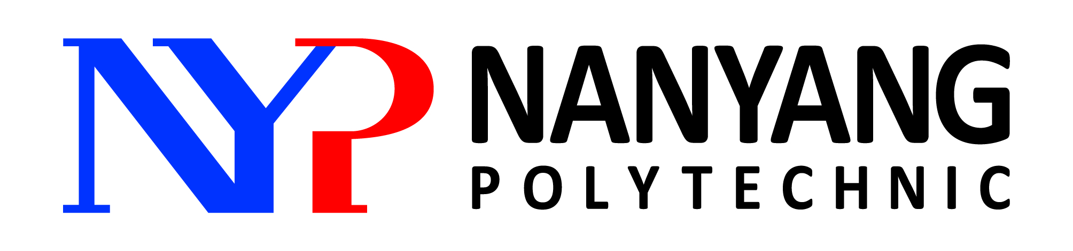
Doing Business Globally
BMX305 Doing Business Globally
Country External Factors –
POLITICAL
/ LEGAL FORCES
DIFFERENCES AMONG COUNTRIES

Slide 2
Political system of a country shapes its economic and legal systems.

Slide 3

Political system – the system of government in a nation
Two dimensions:
Collectivism Individualism
Democracy Totalitarianism
Notes:
https://worldpopulationreview.com/countries/freest-countries/
Freest Countries 2020 1. New Zealand 2. Switzerland 3. Hong Kong 4. Australia 5. Canada 17. USA
25. Singapore Currently, the State of Eritrea and North Korea are the only two nations in the world that still have governments classified as totalitarian dictatorships.

Slide 4
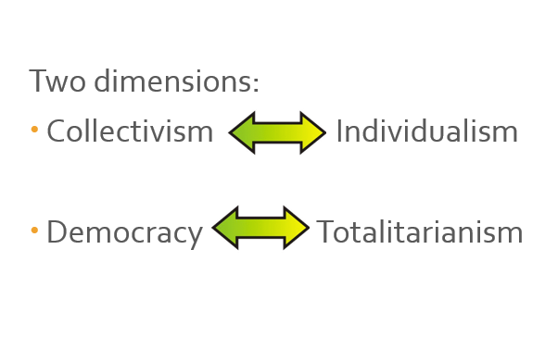
Economic system
Three broad types:
Market economy
Command economy
Mixed economy

Slide 5
Market economy
Most of the productive activities are privately owned (e.g. land, factories etc)
Goods & services that a country produces are not planned
Price system – interaction of supply and demand

Slide 6
Command economy (centrally planned economy)
Government owns the nation’s land, factories and all other economic resources
Allocate & mobilise economic resources
Decide prices
State-owned businesses
E.g. former Soviet Union (set prices for milk, bread, eggs and other essential goods)

Slide 7
Mixed economy
Between market economies and command economies
Certain sectors are left to private ownership
Government takes over ownership of troubled businesses (vital to national interests)

Slide 8
Political forces that affect global trade
Governments & ownership of business
Government stability & protection
Government intervention in trade

Slide 9
Governments & ownership of business
Nationalisation – the taking of private property by a government to make it public
Privatisation – the selling of government owned property to the private sector
https://www.vicepresidencia.gob.bo/IMG/jpg/foto_vale_2-7.jpg
Oil companies, banks, railway, newspaper etc.
Notes:
1938 Mexican President Lázaro Cárdenas expropriated the assets of nearly all the foreign oil companies operating in Mexico – claiming they were rebelling against him – and later creating Petroleos Mexicanos (Pemex)
In 1951, Iranian prime minister Mohammed Mossadegh led moves to nationalise the Anglo-Iranian Oil Company, one of the forerunners of BP.
Codelco, Chile’s state-owned mining company, was created in 1971 when congress unanimously approved the nationalization of all copper mines.
In 2007 Hugo Chavez of Venezuela took control of multi-billion oil projects in the Orinoco belt from ExxonMobil and ConocoPhilips, one of his first moves in a wave of nationalisations of the country’s industries.
Rosneft, Russia’s state-owned oil company, in effect swallowed the main production unit of Yukos, the country’s largest and most successful private oil company, in 2004 after it was hounded to death and then gutted by the government. The Yukos oil group went on to seek up to $100bn in damages.
Shortly after becoming president of Bolivia in 2006, Evo Morales decided to nationalise the country’s oil and gas reserves. At the time, the firms with the largest holdings in Bolivia’s energy industry were Petrobras and … Repsol and YPF.
In the same year, the government of President Alfredo Palacio in Ecuador revoked US oil company Occidental’s operating contract and seized $1bn of its assets, saying that the company had improperly transferred a 40 per cent interest in its oil fields to EnCana of Canada in 2000.
In 2012, Cristina Fernández, Argentina’s president, announced the renationalisation of the oil company YPF, ousting the Spanish group Repsol as majority owner and prompting a furious response from Madrid.

Slide 10
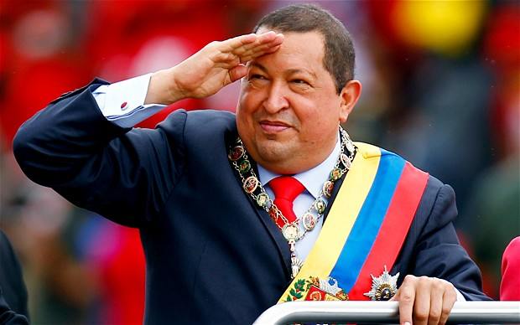
Examples of Highly Negative Political Environment:
Host Government e.g. Venezuela is hostile towards foreign investors.
2007 stripped the world's biggest oil companies of operational control over massive Orinoco Belt crude projects.
2008 Chávez ordered the nationalization of the cement industry.
2008 Chávez ordered the nationalization of Venezuelan steel mill Sidor.
2008 Chávez ordered the take-over of a cement plant owned and operated by Cemex, an international cement producer.
2009 Chávez ordered the army to take over all rice processing and packaging plants.
2010 Chávez signed an ordinance to nationalize six supermarkets under the system of retail stores of a French company
2010 Venezuela announced the intention to nationalize oil drilling rigs belonging to the U.S. company Helmerich & Payne.
2010 Chávez announced that the government was nationalizing two U.S.-owned Owens-Illinois glass-manufacturing plants.
2010 Chávez said his government will take over the Sidetur steel manufacturing plant.
Hugo Chavez 1999-2013

Slide 11
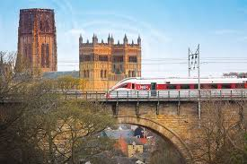
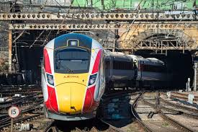
Examples of positive nationalization:
One example of how nationalisation can benefit the public interest is England’s East Coast Main Line, a rail route running from London to Edinburgh. In 1997, the line was privatised, but in 2009 operator National Express East Coast was stripped of the franchise after getting into financial difficulties.
The line was then returned to state control for the next six years (2009-2015), during which period customer satisfaction rose significantly. The government-owned line also turned a healthy profit, returning around £200m a year to the Treasury.
https://www.theweek.co.uk/101318/the-pros-and-cons-of-nationalisation#:~:text=One%20example%20of%20how%20nationalisation,after%20getting%20into%20financial%20difficulties.

Slide 12
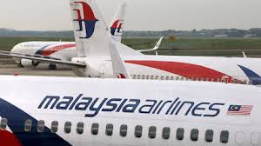
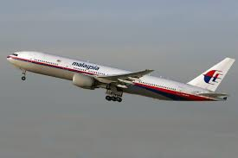
Examples of positive nationalization:
Malaysia’s state investment fund has unveiled plans to make Malaysia Airlines fully government owned, as it prepares to carry out a far-reaching overhaul of the carrier that is reeling from double disasters.
In August 2014, majority shareholder, Khazanah Nasional, said it would purchase all minority shares and finalise a restructuring plan by the end of the month.
https://www.aljazeera.com/economy/2014/08/08/malaysia-airlines-to-be-nationalised/#:~:text=Malaysia's%20state%20investment%20fund%20has,is%20reeling%20from%20double%20disasters.

Slide 13
Political forces that affect global trade
Governments & ownership of business
Government stability & protection
Government intervention in trade

Slide 14
Government
stability & protection
Stable government with policies that are permanent or that change only gradually
Social stability (threats like strikes, protests, robbery, kidnapping) – protection & safety for assets and people
Protection from other threats e.g. terrorism, cybercrime

Slide 15
Political forces that affect global trade
Governments & ownership of business
Government stability & protection
Government intervention in trade

Slide 16
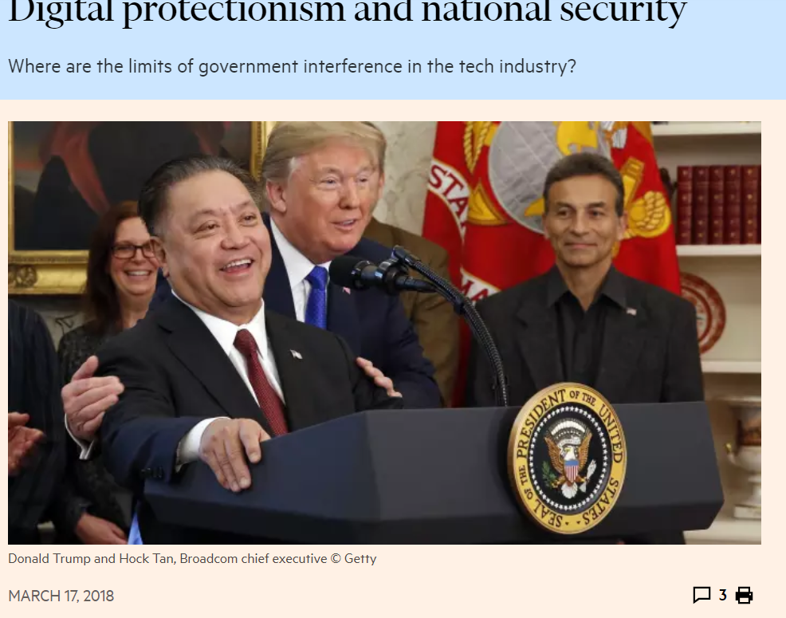
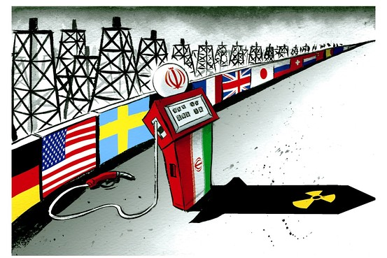

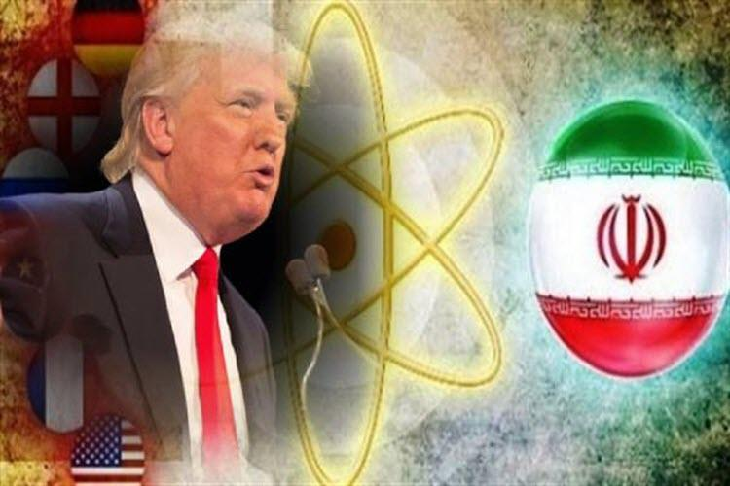
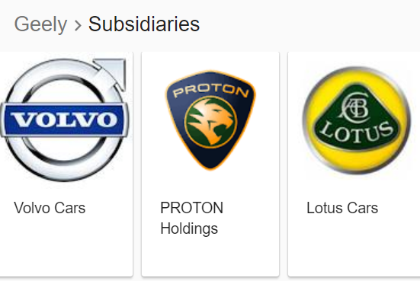
Government intervention in trade
Government’s reasons:
Provide for national defence
Impose sanctions – to punish other nations
Protect an infant or dying local industry
Protect domestic jobs
Ensure fair competition
Retaliate
Notes:
https://www.cnbc.com/2018/03/13/trump-blocks-broadcoms-qualcomm-takeover-concerns-about-china-5g.html
2015 - Singapore-incorporated Avago to buy Broadcom for $50b in biggest-ever chip deal
May 2018 - President Donald Trump ordered the immediate and permanent end of takeover talks between the rival chipmakers Monday, citing national security concerns.
Qualcomm had resisted a deal for months, rejecting several record-breaking price tags.
Broadcom remained committed to a merger, despite growing concerns from regulators. It promised U.S. investment in 5G if the deal went through and advanced a plan to move its headquarters to the U.S. from Singapore.
https://www.vox.com/world/2018/5/8/17328520/iran-nuclear-deal-trump-withdraw:
It’s hard to understand the motivation for doing this without looking beyond policy and into politics. During the 2016 presidential campaign, Trump repeatedly called the Iran deal “the worst deal ever,” once giving the headline speech at an anti-deal rally. And a priority for this administration has been tearing down accomplishments of the prior president, be they Obamacare or the Paris climate accord; the Iran deal fits squarely under this umbrella.
Trump’s recent Cabinet reshuffle also made his decision seem inevitable. The president fired Secretary of State Rex Tillerson and National Security Adviser H.R. McMaster, both of whom thought the US should stay in the deal, and replaced them with Mike Pompeo and John Bolton, respectively. Both Pompeo and Bolton are Iran hawks who have long opposed the deal. In effect, Trump was surrounded by yes men while he made one of the most consequential decisions of his presidency.

Slide 17
Government intervention in trade
Impact on business:
Tariffs – increase costs
Subsidies to local businesses
Customs & other administrative procedures – costly processes
Additional standard requirements – higher costs

Slide 18
Legal forces that affect global trade
Legal systems
International legal forces
Intellectual property rights
Competition Laws / Antitrust Laws

Slide 19
The Corruption Perceptions Index (Transparency International) 2019
Legal systems
Ranking | Country | CPI Score
1 | New Zealand | 87
1 | Denmark | 87
3 | Finland | 86
4 | Sweden | 85
4 | Switzerland | 85
4 | Singapore (least corrupted country in Asia), | 85
Level of bureaucracy
Strength of the courts of justice
Level of corruption
177 | Yemen | 15
178 | Syria | 13
179 | South Sudan | 12
180 | Somalia | 9
The Corruption Perceptions Index
(Transparency International)
2019 World’s Best (Score 0 to 100)
Notes:
https://www.theguardian.com/global-development/datablog/2015/jun/02/global-ranking-corruption-world-justice-project-aims-promote-good-governance
measure justice and corruption and governance

Slide 20
Legal forces that affect global trade
Legal systems
International legal forces
Intellectual property rights
Competition Laws / Antitrust Laws

Slide 21
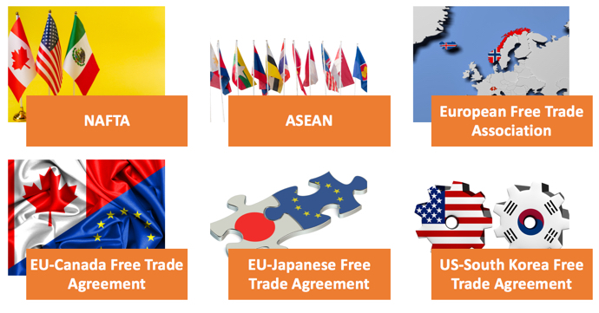
International legal forces
Protection of investors’ interests or human rights of local people
International law – agreement between countries

Slide 22
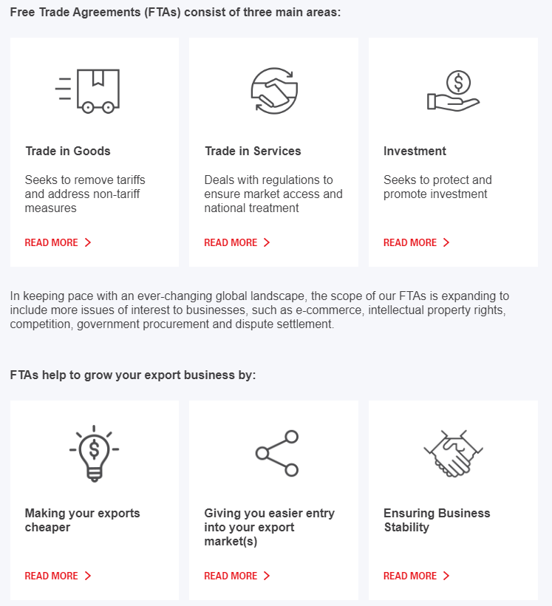
International legal forces
Singapore is part of 25 FTAs (regional and bilateral)

Slide 23
Legal forces that affect global trade
Legal systems
International legal forces
Intellectual property rights
Competition Laws / Antitrust Laws

Slide 24
Intellectual property rights
Patents
World Intellectual Property Organisation (WIPO) – UN
Trade-Related Aspects of Intellectual Property Rights (TRIPS) – WTO
Trademarks
Trade names
Copyrights
Trade secrets

Slide 25
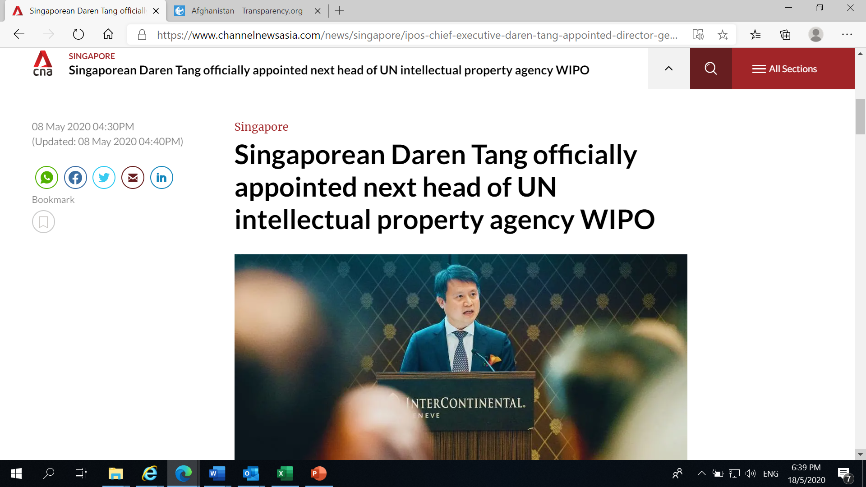
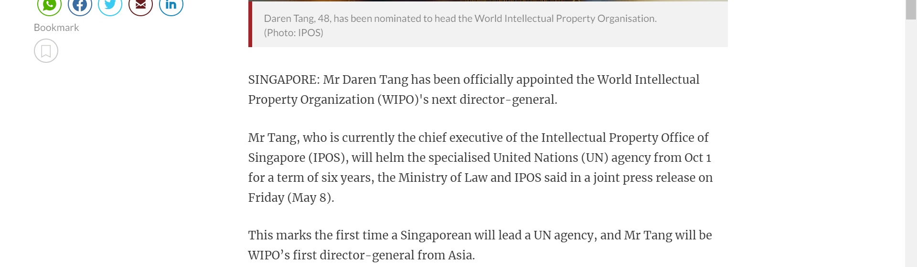

Slide 26
Legal forces that affect global trade
Legal systems
International legal forces
Intellectual property rights
Competition Laws / Antitrust Laws

Slide 27
Competition Laws / Antitrust Laws
Intended to prevent inappropriately large concentrations of economic power, such as monopolies
Government against business or business against another

Slide 28
Kahoot Quiz

Slide 29
Is the country’s political and legal forces favourable to your business?

